Slide 1

Predicting Customer Lifetime Value (CLV) to Enhance Customer Retention and Revenue
Group 1
Bala Gaurav Reddy Pasam 989467995
Khushbu Singh 989465248
Vishal Sagre 989469775
Hetvi Rajesh Bhalani 989469635

Slide 2

What Exactly is our Project ?
Project Focus
Leveraging predictive analytics to forecast Customer Lifetime Value (CLV)
Utilizing machine learning and visualization tools to
Expected Outcomes
Identifying key drivers influencing CLV
Optimizing customer retention and revenue generation using predicted CLV and Key Insights
3. Programming and Visualization Tools
Used Python to build and train a predictive model to forecast CLV.
Leveraged Tableau dashboards uncovering significant trends and Insights on customer demographics, sales channels, and policy types.
Managerial Implication.
Actionable recommendations for resource optimization and revenue growth
Notes:
This project leverages predictive analytics to forecast Customer Lifetime Value (CLV) using a Random Forest model. Key insights from Tableau dashboards help optimize customer retention and revenue generation, providing actionable strategies for business growth and improving decision-making processes. Abstract: This study focuses on leveraging predictive analytics to forecast Customer Lifetime Value (CLV) for an insurance company. By utilizing machine learning and visualization tools, the project aims to identify key drivers influencing CLV and provide actionable insights to optimize customer retention and revenue generation. A Random Forest model was developed to predict CLV with an R² of 0.69, highlighting the model’s reliability. Insights derived from Tableau dashboards uncovered significant trends in customer demographics, sales channels, and policy types, offering targeted strategies for business growth. The findings contribute to the application of data-driven approaches in improving customer-focused decision-making processes. Keywords: • Customer Lifetime Value (CLV) • Predictive Modelling • Machine Learning • Business Analytics • Tableau Dashboards

Slide 3
Dataset Background
Source of Dataset
Kaggle’s IBM Watson Marketing repository
Customer Records
Over 10,000 records
Attributes Included
Demographic details (e.g., gender, marital status)
Vehicle information
Policy types
Sales channel performance
Target Variable
Customer Lifetime Value
Pre-calculated for training predictive models
Notes:
The dataset from Kaggle’s IBM Watson Marketing repository includes over 10,000 customer records. It features demographic details, vehicle information, policy types, and sales channel performance. The target variable, Customer Lifetime Value, is pre-calculated for training predictive models and deriving insights. Original Content: 1.3. Dataset Background The dataset, sourced from Kaggle’s IBM Watson Marketing repository, comprises over 10,000 customer records. It includes attributes like demographic details (e.g., gender, marital status), vehicle information, policy types, and sales channel performance. The target variable, Customer Lifetime Value, is pre-calculated and serves as the foundation for training a predictive model and deriving insights.

Slide 4
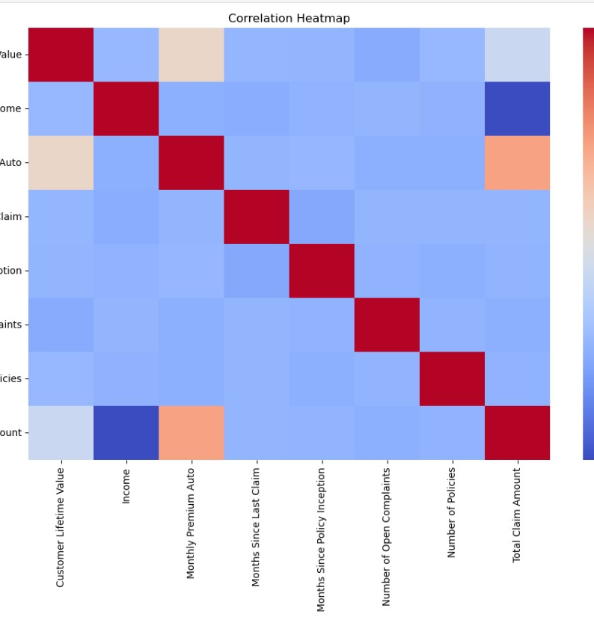
Predictive Modelling with Python
Data Preparation
Cleaned and processed dataset for high-quality inputs
Encoded categorical variables and scaled continuous features
Model Training
Split data into 80% training and 20% testing sets
Trained Random Forest model, optimized hyperparameters using grid search
Evaluation
Achieved R² score of 0.69
Mean Absolute Error (MAE) of $1,473
Results Integration
Appended predicted CLV values to dataset
Further Visualized for Business Insights
Notes:
We prepared the dataset, trained a Random Forest model, and evaluated it with an R² score of 0.69 and MAE of $1,473. Predicted CLV values were integrated into the dataset for deeper insights using Tableau dashboards. Original Content: • Cleaned and processed the dataset to ensure high-quality inputs. • Encoded categorical variables and scaled continuous features for uniformity. b. Model Training: • Split the data into an 80% training set and a 20% testing set. • Trained the Random Forest model using scikit-learn’s implementation, optimizing key hyperparameters such as the number of trees and depth using grid search. c. Evaluation: • Achieved an R² score of 0.69, indicating that the model explains 69% of the variance in CLV. • The Mean Absolute Error (MAE) of $1,473 highlights the model's reliability in predicting CLV values. d. Results Integration: • Predicted CLV values were appended to the dataset, allowing for direct comparisons with existing values and facilitating deeper insights in Tableau. B. Visualization and Business Analytics To complement the machine learning results, Tableau dashboards were developed, offering a user-friendly interface for exploring CLV trends and patterns. These dashboards provided: • Interactive visuals for demographics, policy types, sales channels, and geographic distribution. • Clear identification of actionable business opportunities. 3.3 Analytics and Visualization A. Process Overview a. Exploratory Data Analysis (EDA): • Used Python libraries like pandas and matplotlib to identify trends, correlations, and anomalies in the data. • Key insights, such as the dominance of suburban customers and the popularity of basic coverage plans, informed subsequent analyses. b. Model Development: • Built and evaluated the Random Forest model to predict CLV accurately. • Exported predictions for visualization and further analysis. c. Tableau Dashboards: • Integrated model outputs with interactive visuals to highlight key trends, such as the impact of education level and vehicle class on CLV. B. Key Visualizations a. CLV Distribution: Reveals the skewed nature of customer lifetime value, with a small proportion of high-value customers. b. Geographic Insights: Heatmaps showing state-wise CLV contributions, highlighting California’s dominance and the potential in Oregon. c. Demographic Patterns: Charts showing married women and divorced customers as high-value segments. d. Policy and Coverage Trends: Analysis of popular and profitable plans, with actionable insights for improving premium plan adoption. C. Managerial Implications of the Methodology The insights derived from this analysis are critical for decision-making: a. Resource Allocation: Predicted CLV values enable managers to prioritize high-value customers for retention campaigns. b. Targeted Marketing: Visual trends guide personalized marketing strategies for specific customer demographics, such as luxury vehicle owners or high-educated retirees. c. Policy Optimization: Analysis of popular vs. profitable plans highlights opportunities for upselling and developing new policy tiers. d. Geographic Strategy: Heatmaps identify underperforming regions like Nevada, informing targeted campaigns for growth. This integrated methodology not only addresses the technical objective of predicting CLV but also provides a robust framework for actionable business strategies. D. Our Tableau Dashboard: 3. Data and Methods 3.1 Data The dataset for this project was sourced from Kaggle's IBM Watson Marketing repository, containing over 5,000 customer records. It includes information on customer demographics, vehicle details, policy types, and sales channel performance. The primary objective of using this dataset was to predict the Customer Lifetime Value (CLV) and identify key factors driving its variability. A. Data Features a. Demographic Attributes: o Gender, marital status, and education level. o Insight into customer profiles and behavioural patterns. b. Vehicle Details: o Vehicle class (e.g., luxury, economy), size, and type. o Important for understanding insurance needs and risk factors. c. Policy Information: o Policy type (e.g., corporate, personal), coverage type (basic, premium), and renewal offers. d. Sales and Geography: o Sales channel (agent, branch, web, call center) and customer state. o Provides insight into how and where policies are purchased. e. Target Variable: o CLV: Represents the total revenue generated by a customer over their lifetime relationship with the company. B. Data Cleaning and Transformation a. Handling Missing Values: Default imputation strategies were applied for consistency. b. Encoding Categorical Variables: Categorical data such as Policy Type and Education Level were transformed using one-hot encoding for machine learning compatibility. c. Feature Scaling: Continuous features like Income and CLV were normalized to ensure consistency and enhance model performance. d. Outlier Detection: Extreme values in CLV were examined and retained to preserve variability essential for the insurance industry. 3.2 Methods A. Predictive Modelling with Python The core of the analysis involved building a predictive model for CLV using Python. A Random Forest Regressor was chosen for its ability to handle non-linear relationships and complex feature interactions effectively. The modeling process included: a. Data Preparation:

Slide 5
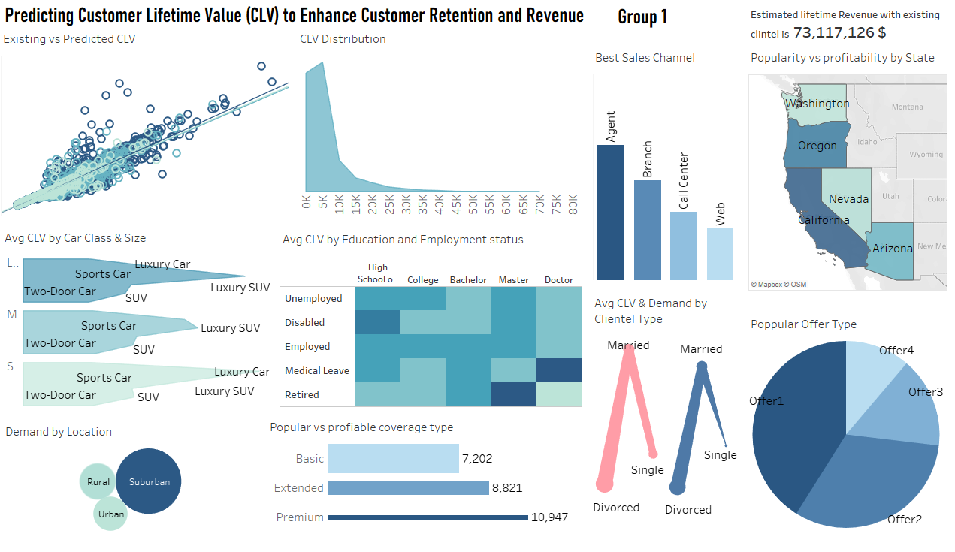
Our_dahboard

Slide 6

Key Findings
Customer Demographics: Married women dominate in client count, but divorced women contribute the highest average CLV. Educated retirees and individuals on medical leave show high profitability.
Coverage Types: Premium coverage has the highest average CLV but the lowest adoption. Basic coverage is popular but less profitable.
Sales Channels: Agents lead in total CLV, call centres generate the highest average CLV, and web channels underperform in both metrics.
Geographic Distribution: California and Oregon dominate in total CLV; Nevada has the highest average CLV per client.
Policy Trends: Luxury vehicles, especially small luxury cars, drive the highest CLV. Economy vehicles dominate in volume but yield low profitability.
CLV Distribution: The majority of customers have CLV below $15,000, with a small segment of high-value customers driving revenue.
Offer Effectiveness: Offer1 leads in both client count and total CLV, while other offers show potential for enhancement.
Rural Market: Rural areas have untapped potential due to low client density and average CLV.

Slide 7

Insights and Managerial Implications
Retention Strategies: Focus on loyalty programs and premium benefits for high-CLV segments, such as luxury car owners and educated retirees.
Upselling Opportunities: Encourage basic policyholders to upgrade to premium coverage through targeted marketing and mid-tier policy options.
Channel Optimization: Improve web channel performance with AI-driven recommendations and dynamic pricing; enhance call centre training for high-value interactions.
Geographic Focus: Expand in underperforming regions like Arizona; strengthen retention in high-CLV regions such as Nevada.
Product Differentiation: Introduce exclusive services for luxury vehicle owners and value-add offerings for economy car customers.
Family-Centric Campaigns: Design policies targeting married women, emphasizing long-term benefits like family protection.
Niche Segments: Create tailored offers for high-CLV groups like doctorate holders on medical leave and retirees.
Rural Expansion: Partner with local organizations and develop affordable bundles to penetrate rural markets.

Slide 8

This project highlights the value of predictive analytics in forecasting Customer Lifetime Value (CLV) and driving actionable business strategies. Key insights reveal opportunities to:
Target high-CLV segments like premium coverage and luxury vehicle owners.
Optimize underperforming regions and sales channels for growth.
Enhance customer retention with tailored campaigns for niche demographics.
By combining machine learning and visualization, we provide a clear roadmap for improving customer retention, revenue, and strategic decision-making, ensuring sustainable business growth.

Slide 9

Thank You! We Appreciate any Doubts and Questions ?

